Slide 1

CDK Cloud Development Kit Workshop WS 201
Agenda
Day 01
Logistic
Introduction to CDK
Bootstrapping CDK
Workshop
namespace in cdk
First CDK real App
Lambda with CDK
Exercise
Day 02
Advance CDK
Nested Stack
Constructs
Patterns
CDK v2
Q & A

Slide 2

CDK Introduction
Declarative vs Programmatic
Unit Test your Infrastructure
Object Oriented Framework
Multi Language Support
Typescript, Javascript, python, java, c#
JSii + TS compiler
JavaScript Interoperability interface
Comparison with serverless – Let’s try to avoid that

Slide 3
CDK Advantages
Use logic (if statements, for-loops, etc) when defining your infrastructure
Use object-oriented techniques to create a model of your system
Define high level abstractions, share them, and publish them to your team, company, or community
Organize your project into logical modules
Share and reuse your infrastructure as a library
Testing your infrastructure code using industry-standard protocols
Use your existing code review workflow for Infrastructure
Code completion within your IDE
Declarative is good, Programmatic is great, fits well with Developer DNA.

Slide 4
How Infrastructure as Code works?

Slide 5
CDK Main Components
Notes:
cdk deploy
cdk diff
cdk destroy
cdk list

Slide 6
Fun times
https://bitbucket.collegeboard.org/projects/TEC/repos/cdk-workshop-ws201/browse
cdk bootstrap tool
cdk namespace and first workshop

Slide 7
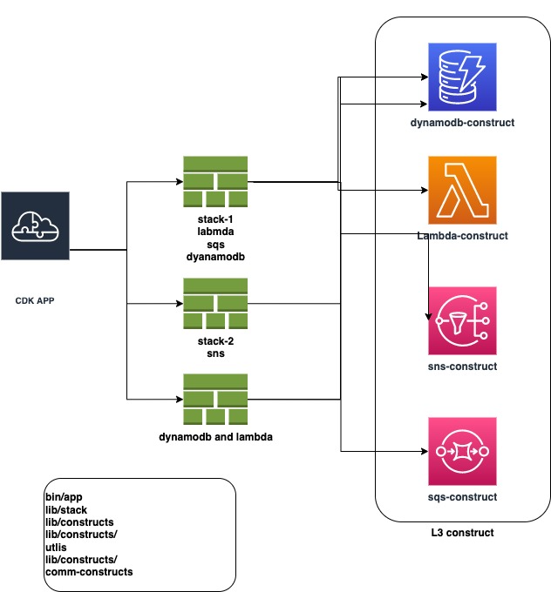
CDK Introduction
Typical structure

Slide 8
Thank You – TechEd Team
Office Hours Next week

